Slide 1
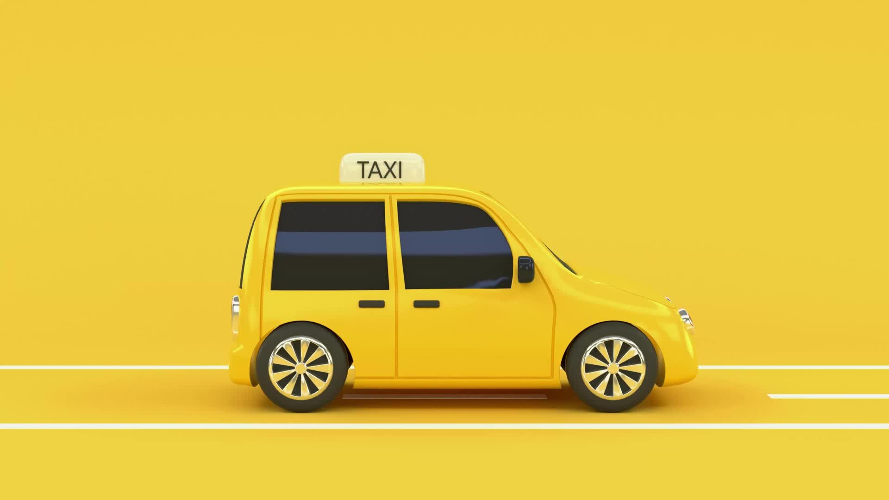
TAXI RESERVATION SYSTEM
BOOK YOUR TICKETS

Slide 2

S.S.S.S.S. RAM SINGH BISHT
GOVT. POLYTECHNIC DWARAHAT(ALMORA) UTTARAKHAND
Guided by:
Miss Neha Bora
Presented By :
Vivek Joshi 18007120026
SurajBhan 18007120021
Ajay Singh Kiroula 18007120002
Subham Pandey 19007122002

Slide 3
ABSTRACT
As we all know that the most of the Government Engineering College are located at such places which are not developed well and are at rural places. Like that in
Dwarahat we have two engineering colleges (Government Polytechnic & B. Tech), Large Number of students take admissions in these two colleges every year.
Due to the location of the colleges student faces many problem as the Station (Bus & Taxi Stands) are far away from the colleges, Hostels and those who live by taking rooms. And students residential houses are located far away from these colleges.

Slide 4
MODULES
Booking: This system can book tickets of the passengers.
Passenger Details : The system stores all the necessary information of the passengers.

Slide 5


LANGUAGE USED
PYTHON (Tkinter library)
SQ Lite3 (Sequence Quarry)

Slide 6
SOFTWARE USED
Visual Studio Code
DB Browser For SQ Lite

Slide 7
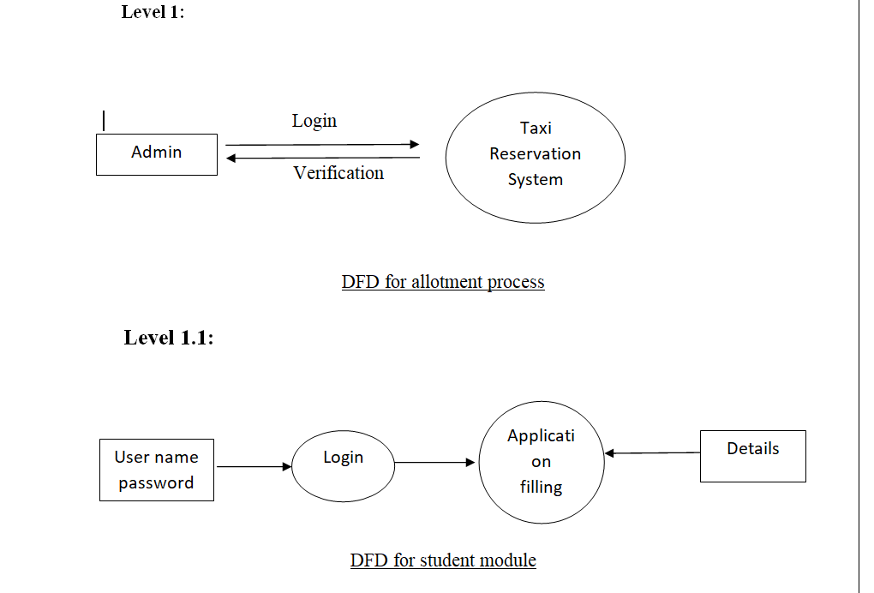
DFD (DATA FLOW DIAGRAM)

Slide 8
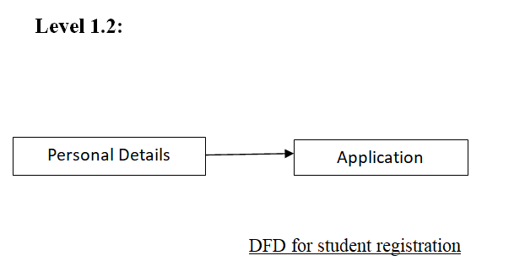

Slide 9
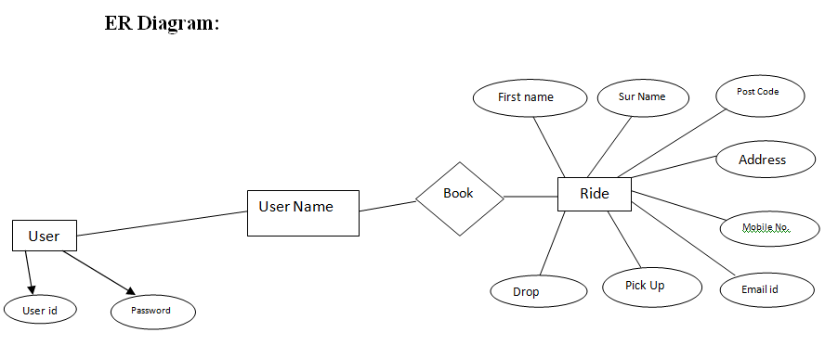

Slide 10
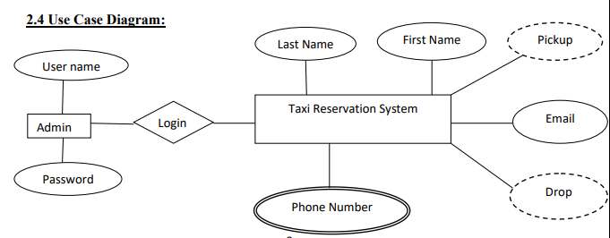

Slide 11
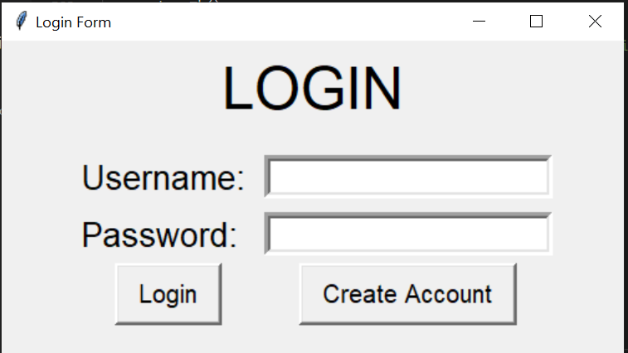
HOME PAGE

Slide 12
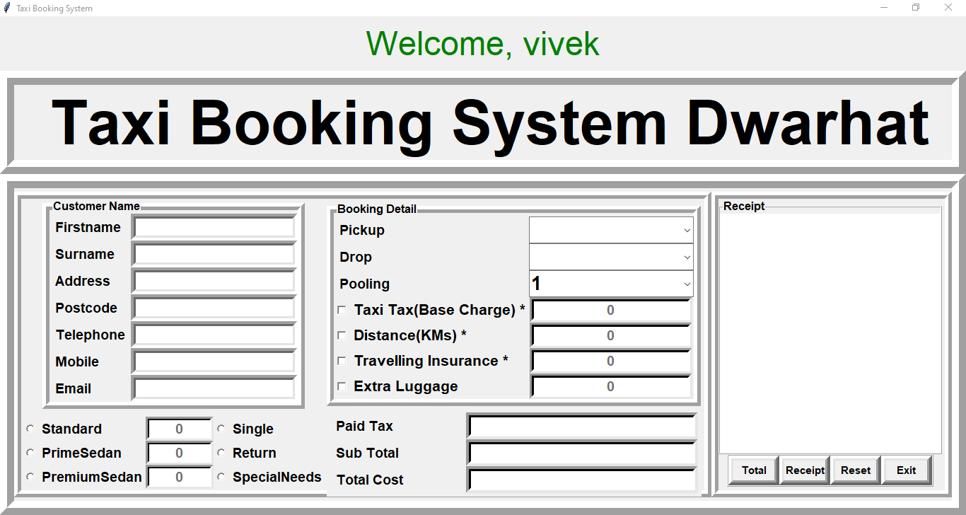
USER REGISTRATION PAGE

Slide 13
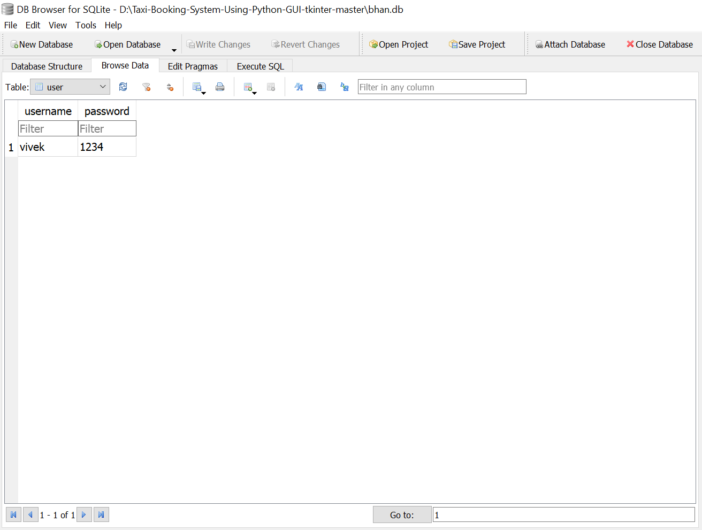
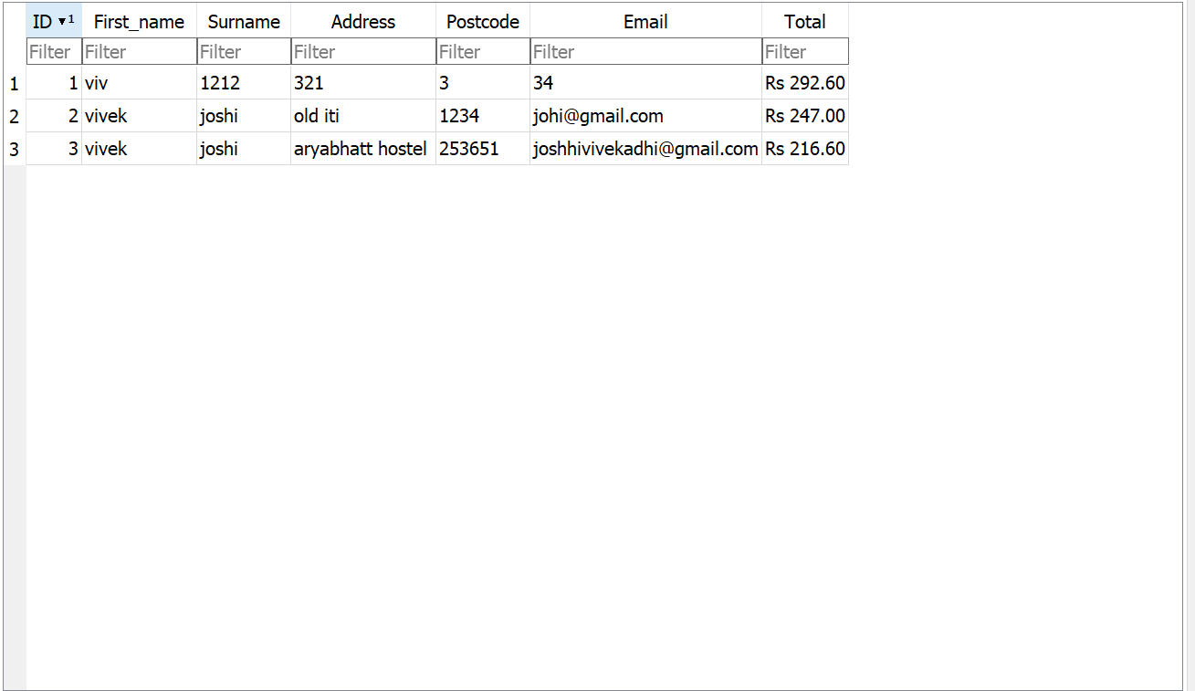
DATA BASE

Slide 14
CONCLUSION & FUTURE SCOPE
Conclusion :- This project is about the designing Prepaid taxi management system using python (tkinter) and SQ lite3 using DB browser for SQLite . This project presents an investigative view of presenting the taxi management system . Present system of taxi management system is having some shortcoming on which we have tried to work on that to eliminate the disadvantages. There are options for new entry which will be stored in SQ lite3database and retrieved from database in future. Taxi reservation system is an innovative thought to simplify the Transportation problems .
Future Scope :- We can enhance our project by adding more feature in future time.
Multi users can access this app in future ,as now only admin can access.
In future taxi driver will automatically be informed about the reservation of the student as now the admin has to informed the driver about the reservation of the students.
In the last we conclude that Indian taxi is having a strong IT Infrastructure and a well-equipped taxi management system but there is some shortcoming in the system on which we have tried to work on it on future time.

